Slide 1
Bakery Revenue Time Series Analysis

Slide 2
01
Business Goal
Forecasting future Traditional Baguette sales by conducting time series analysis on historical daily sales

Slide 3
02
Dependent Variable
Total Daily Revenue for Traditional Baguettes

Slide 4
03
Dataset - Bakery Data

Slide 5
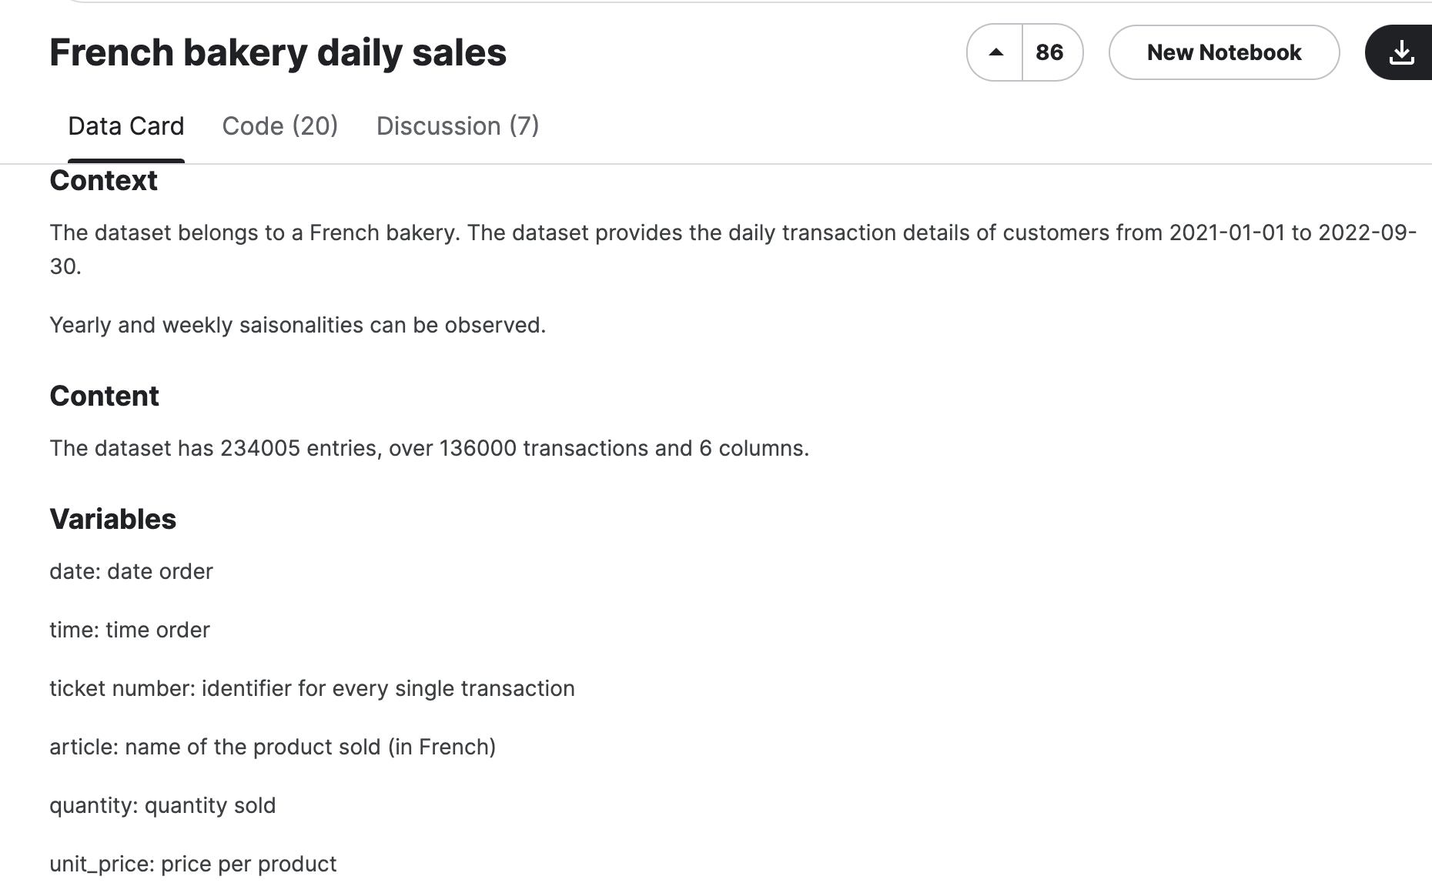
Dataset - Kaggle
https://www.kaggle.com/datasets/matthieugimbert/french-bakery-daily-sales
Our complete dataset contains daily sales of multiple products of a bakery from 2021-2022.
We chose to only focus on “Traditional Baguettes” as they accounted for 23% of total revenue
We converted the time of order by categorizing it into three segments: Morning, Afternoon, and Evening. Subsequently, we employed Excel to convert these categories into a binary format, represented by 1s and 0s.

Slide 6
04
Control Chart - SAS STUDIO

Slide 7
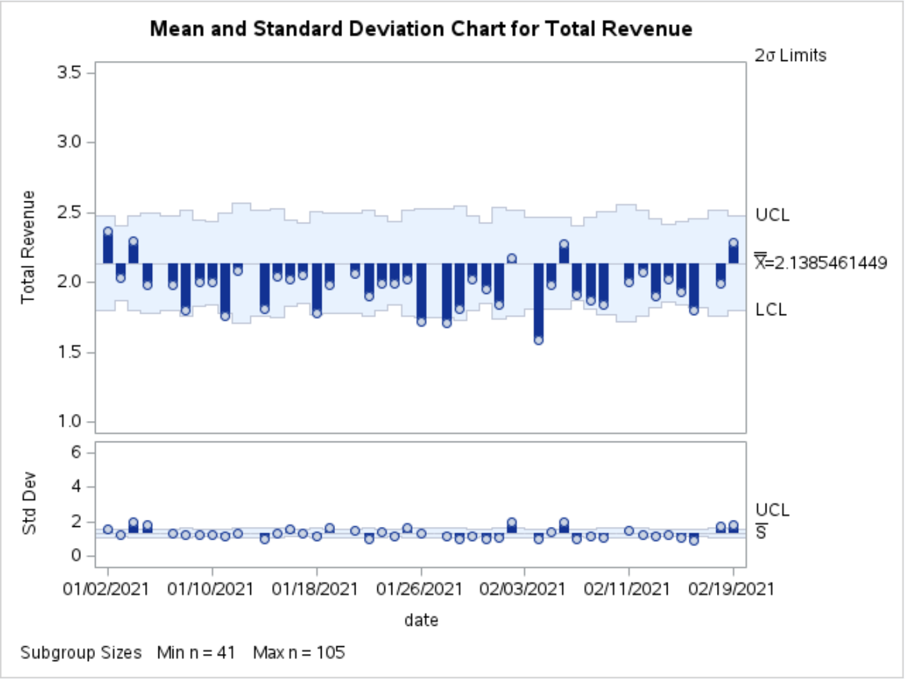
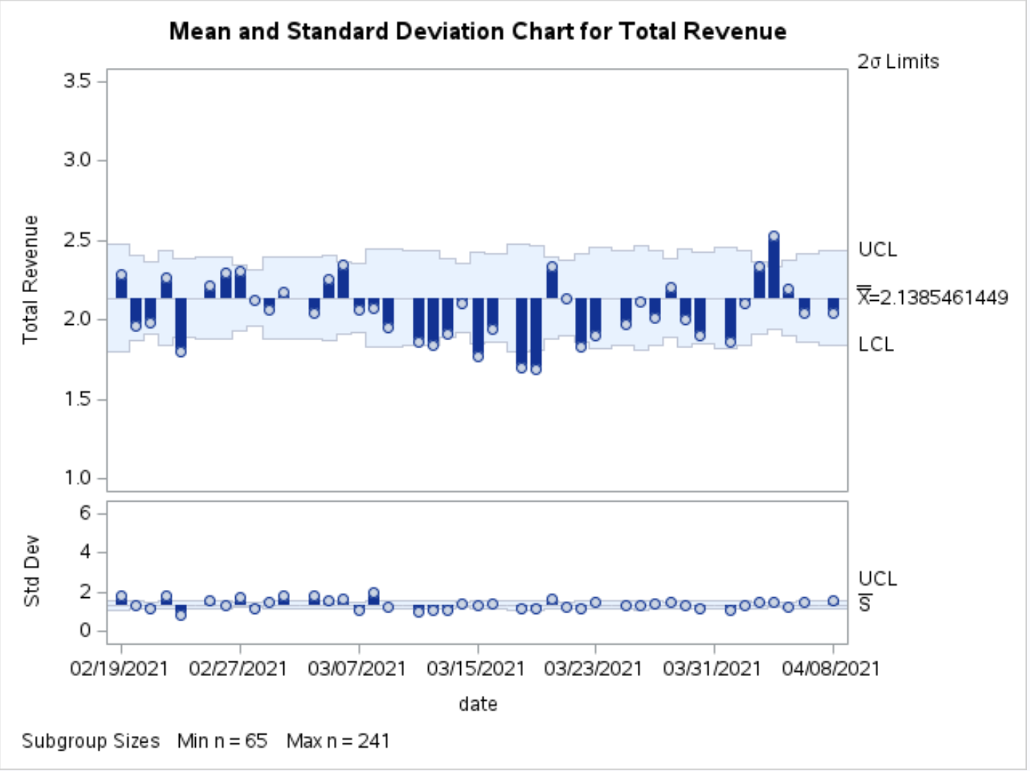
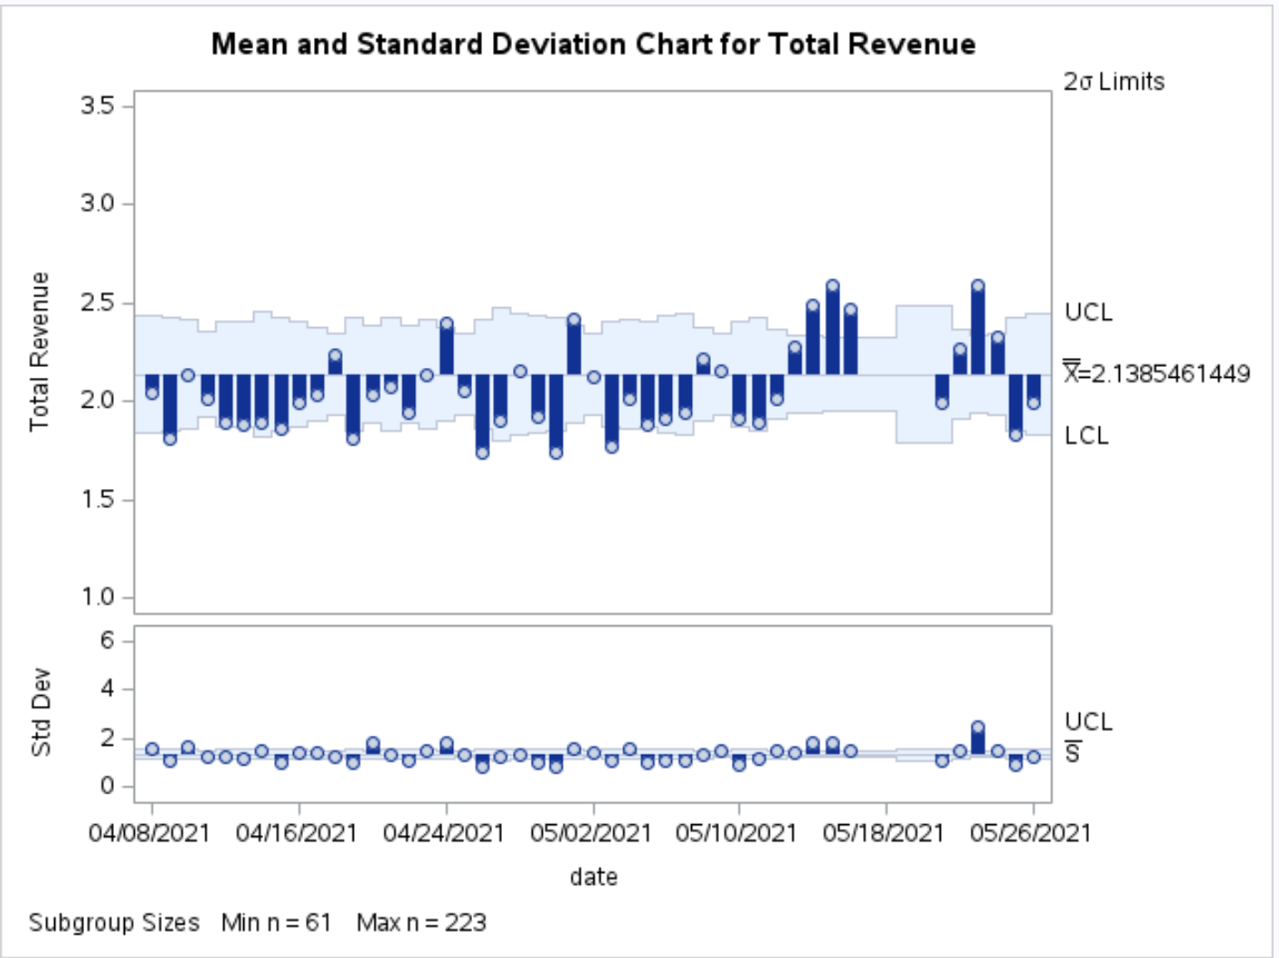
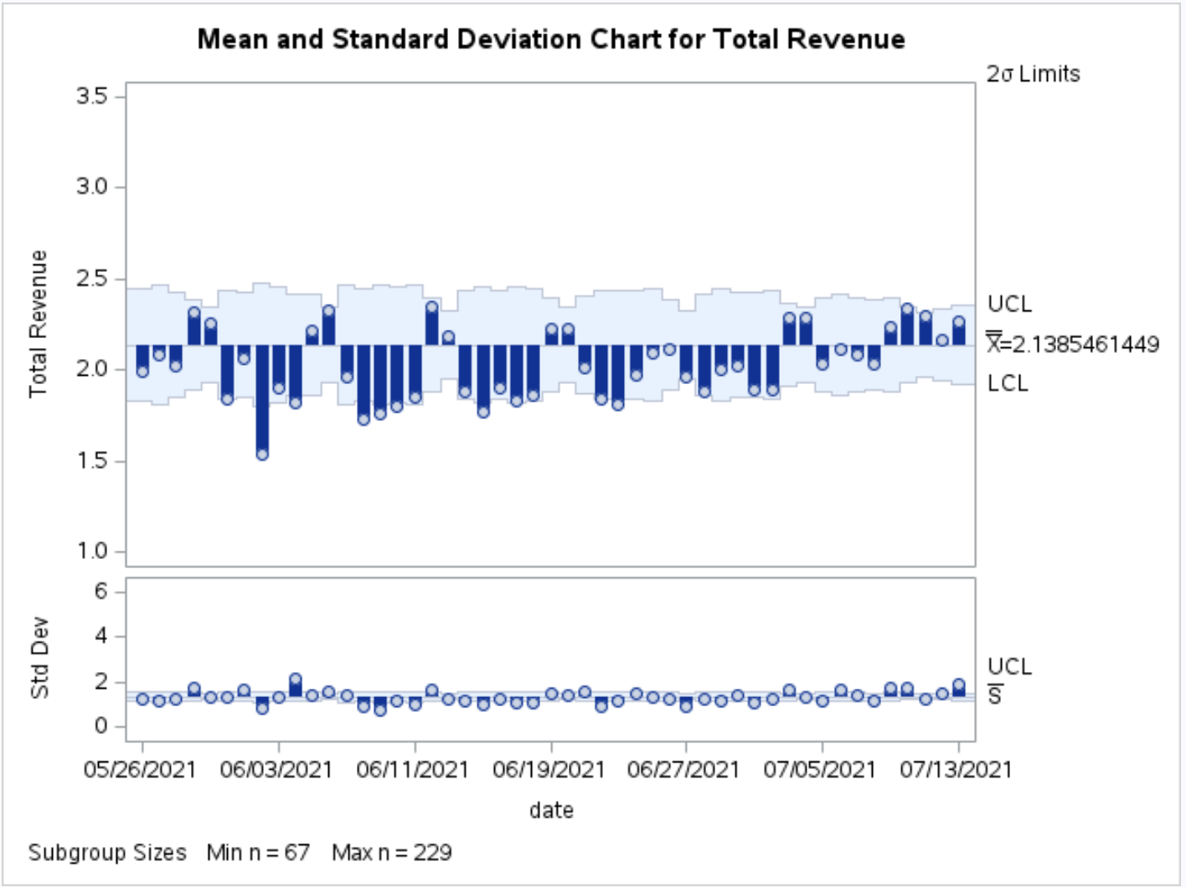
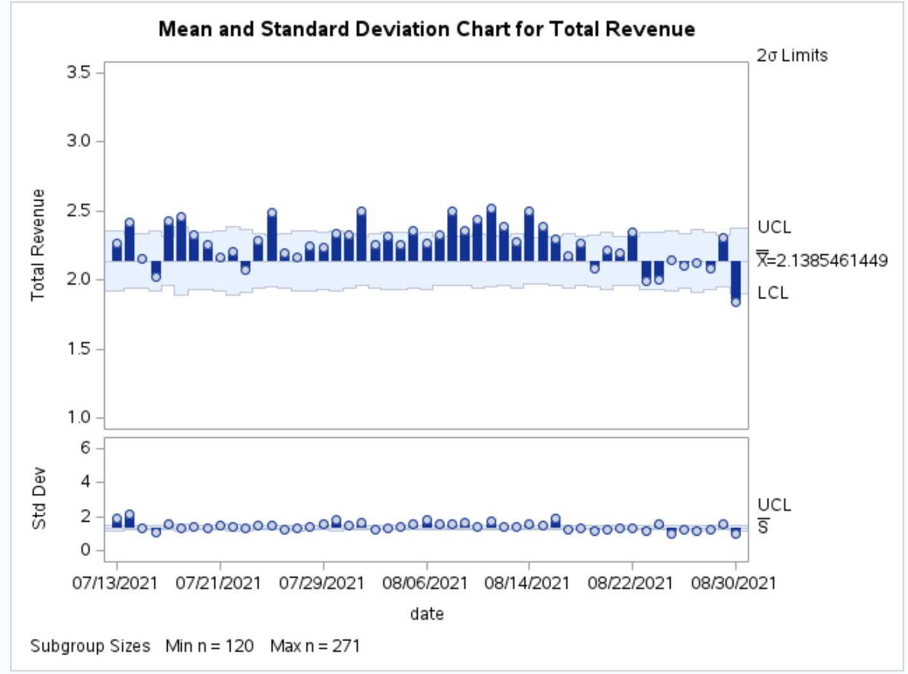
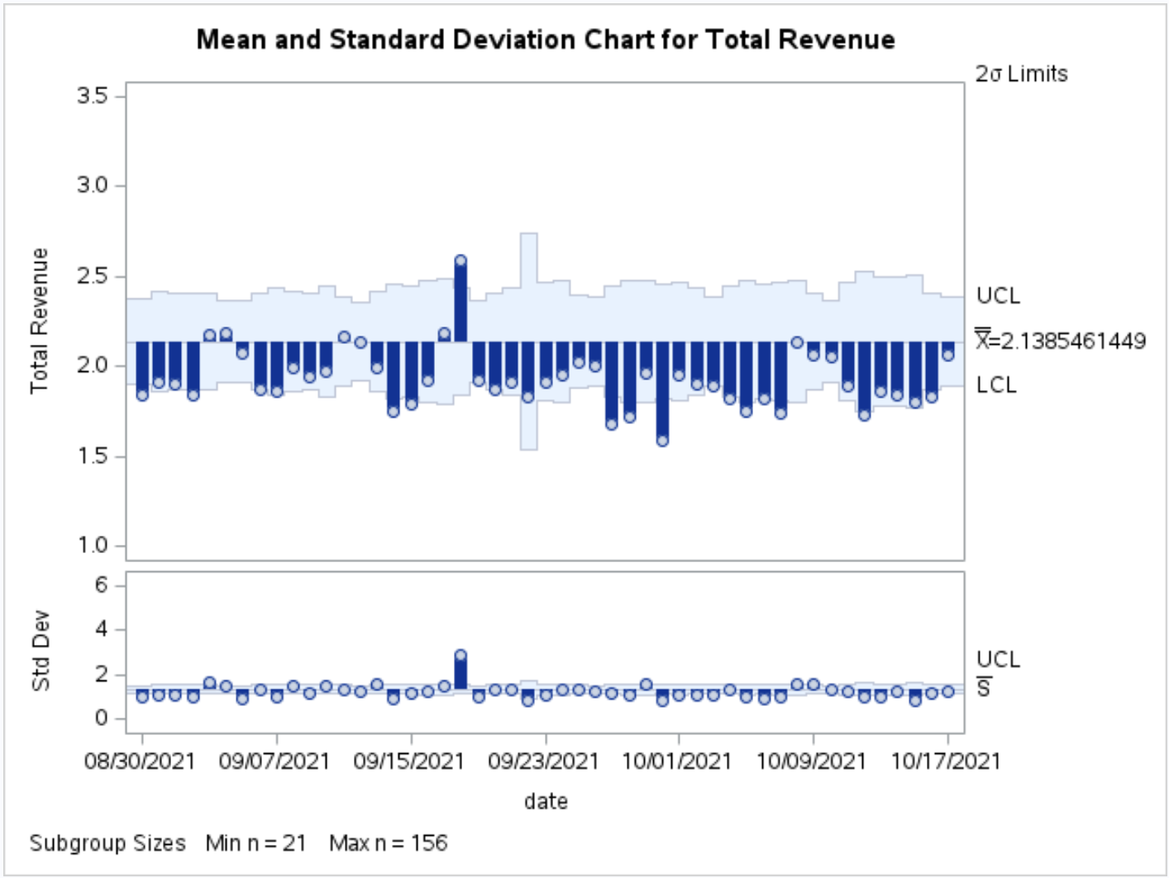
Control Chart in SAS Studio Pt. 1

Slide 8
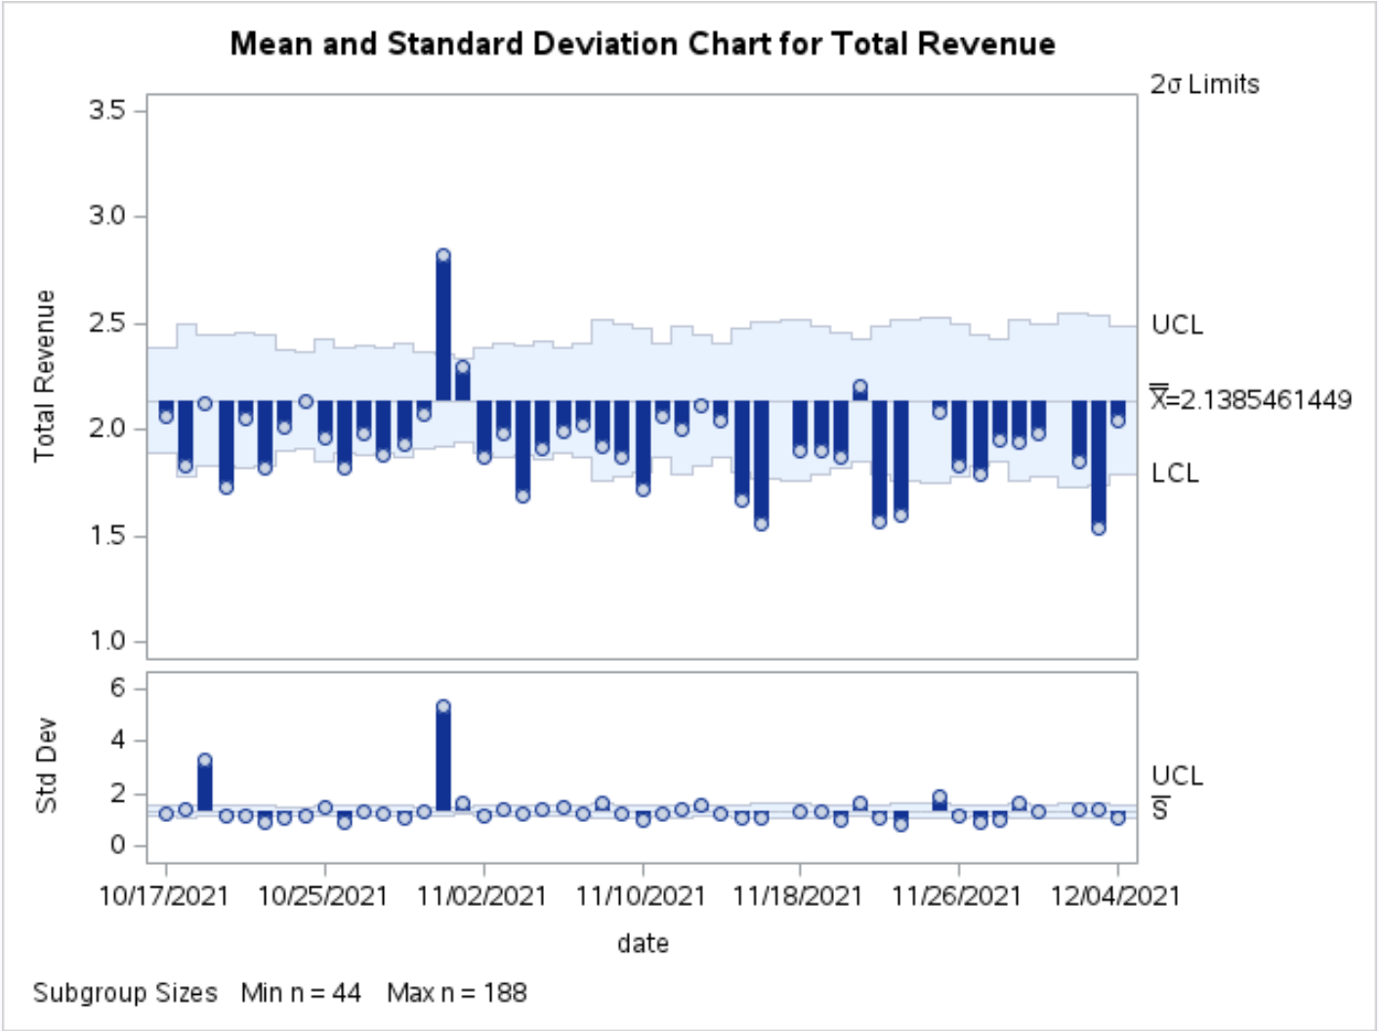
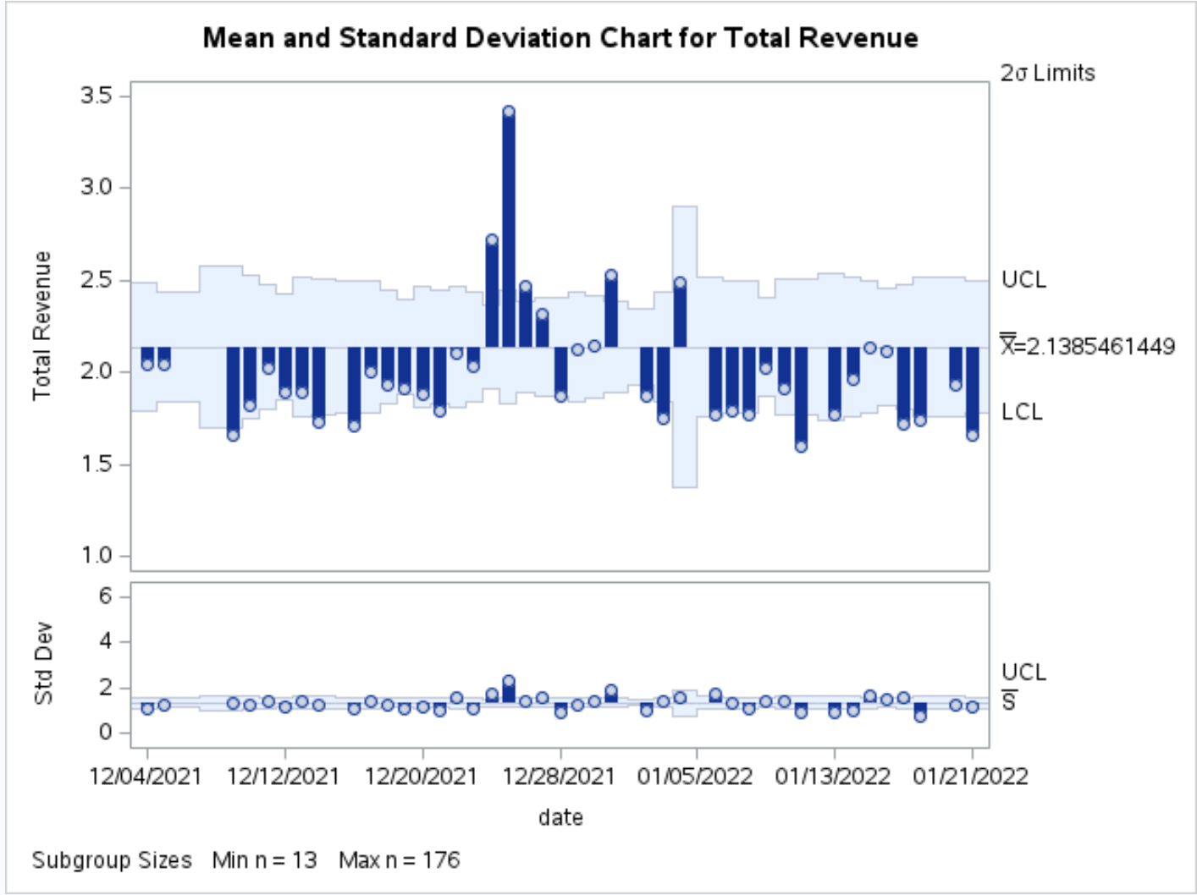
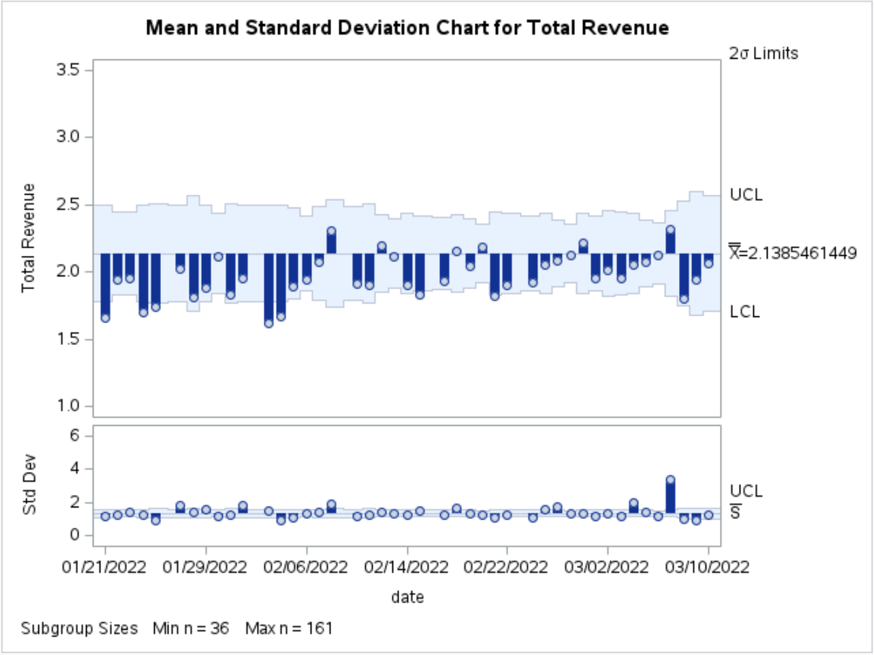
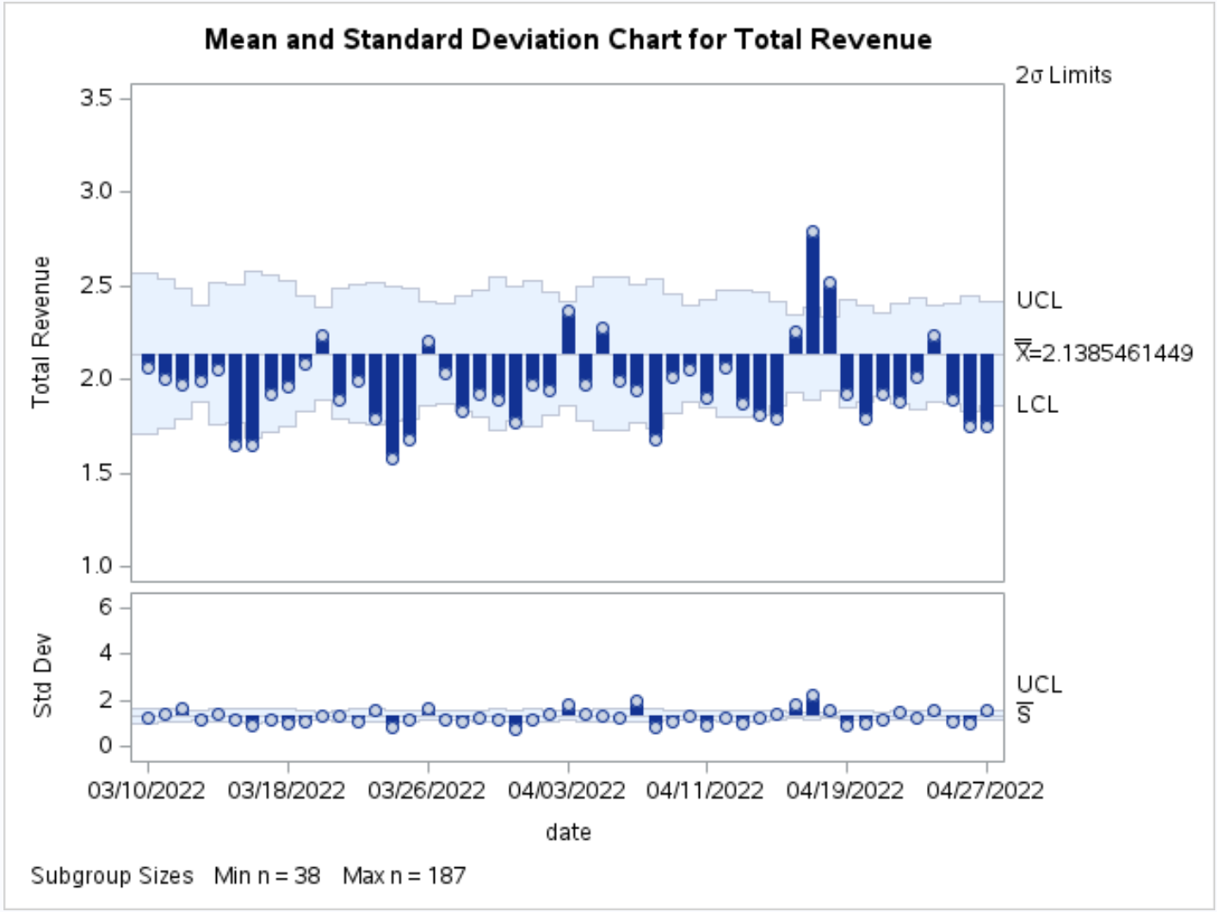
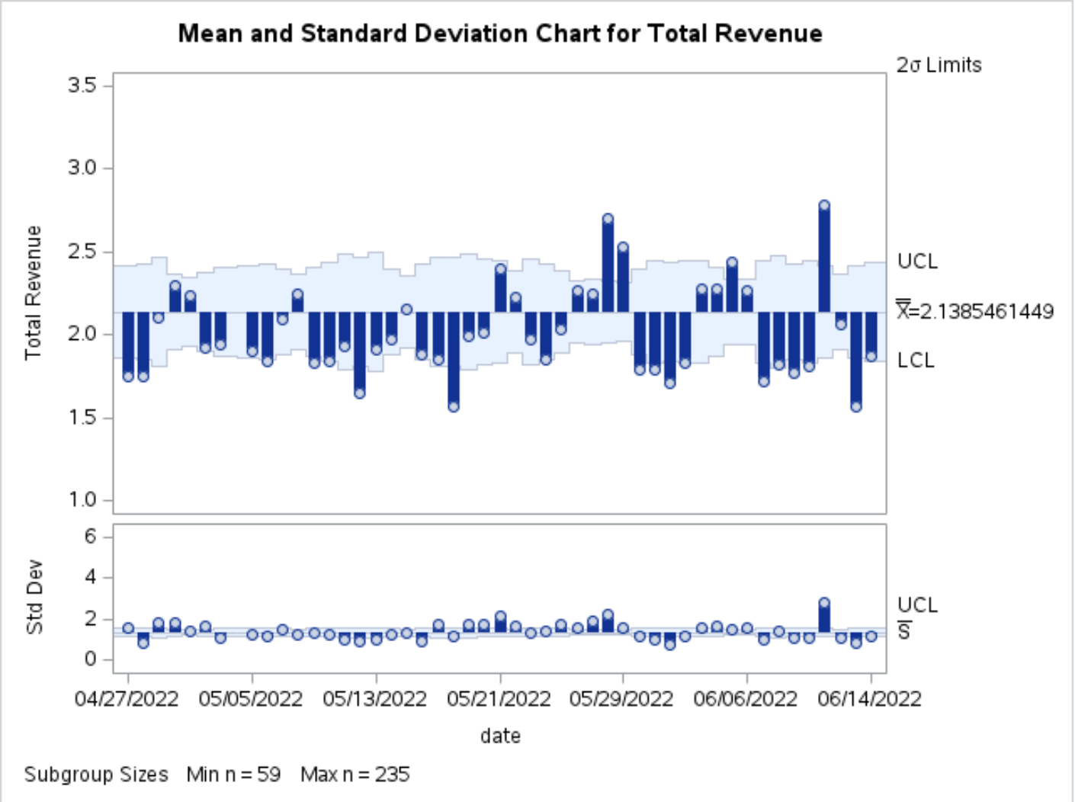
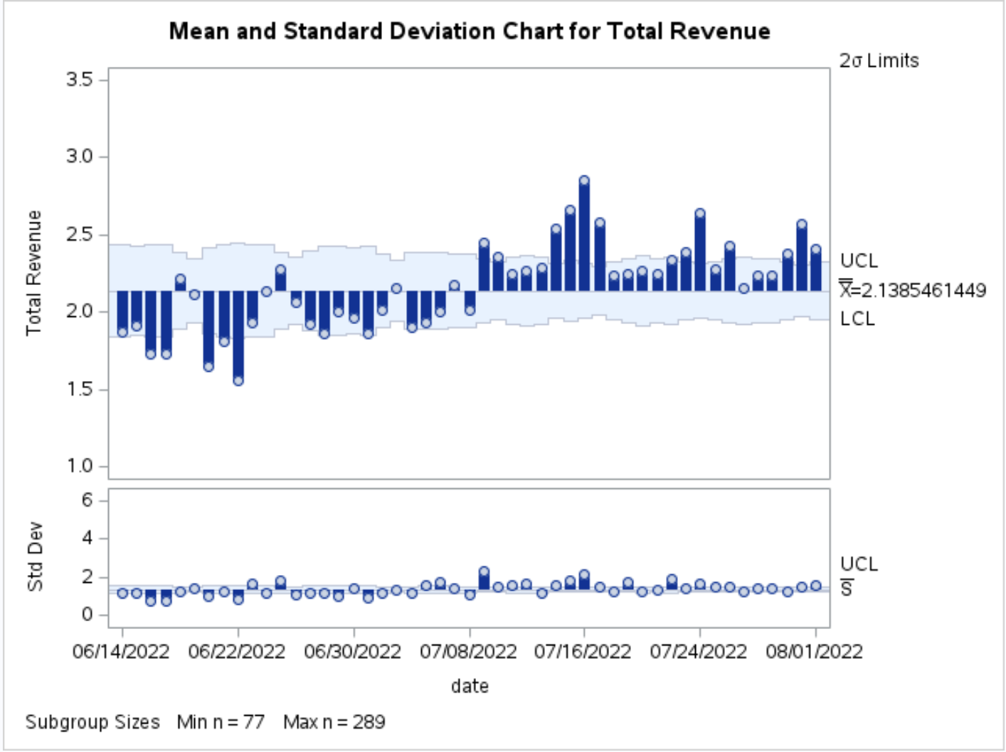
Control Chart in SAS Studio Pt. 2

Slide 9
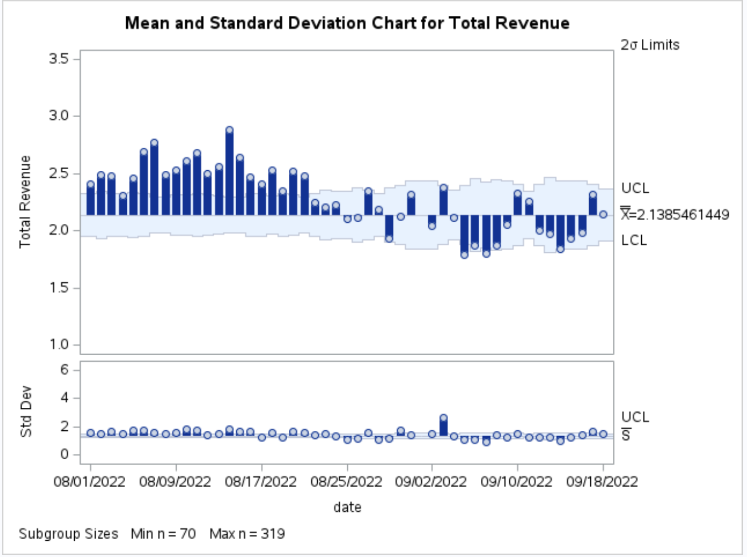
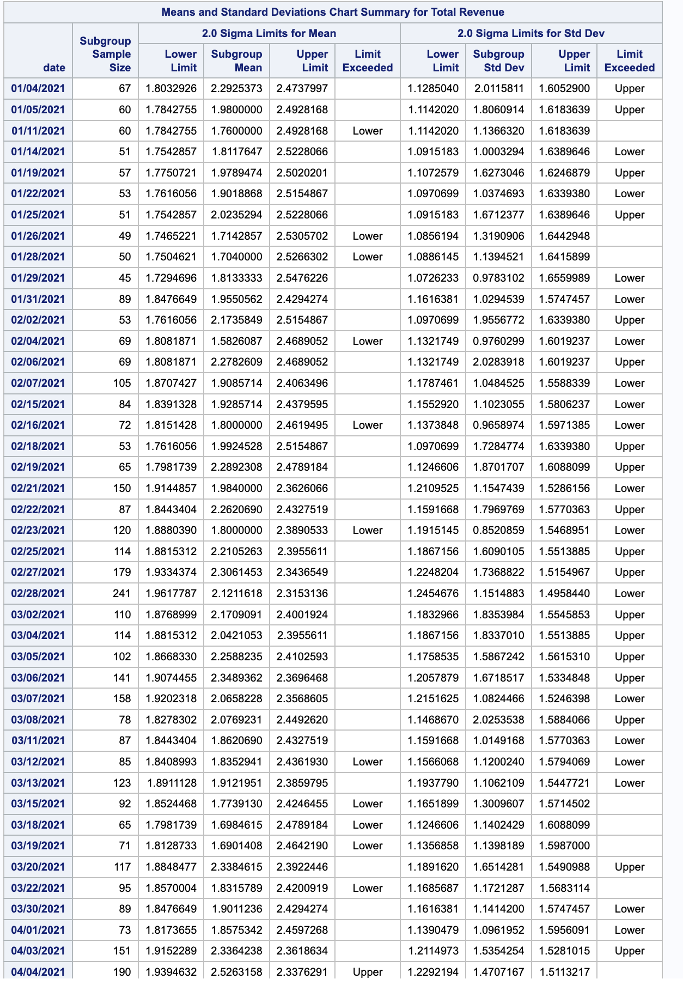
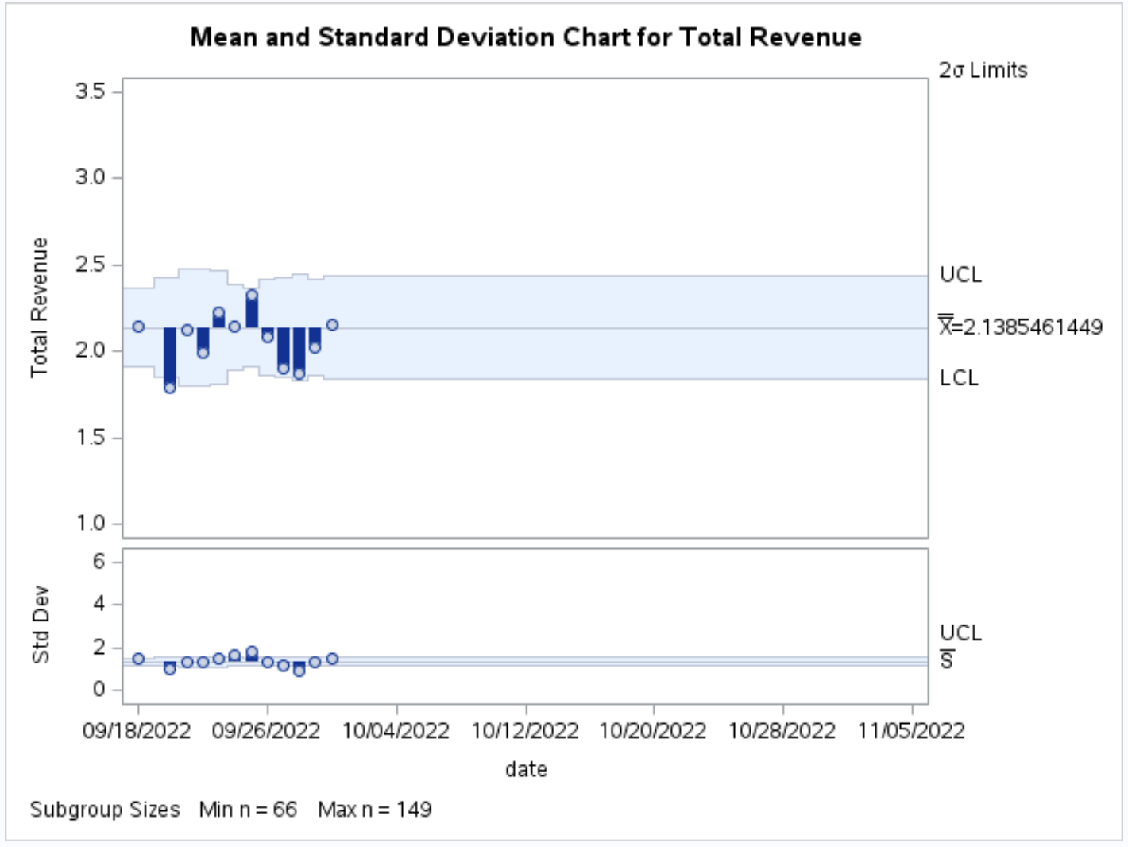
Control Chart in SAS Studio Pt. 3
We chose to implement control charts for both mean and standard deviations due to the expansive scope of our dataset, notably characterized by multiple transactions occurring on the same day
We established our control limits by employing 2 standard deviations, a decision influenced by the considerable volatility observed in sales and the substantial range between our maximum and minimum sales figures
We examined the table summarizing instances of upper and lower limit breaches in the control charts. Notably, with our dataset featuring multiple transactions on the same day, we observed numerous occurrences where total daily revenue might exhibit variations surpassing the 2 sigma limits

Slide 10
05
Univariate Time Series Analysis - SAS STUDIO

Slide 11
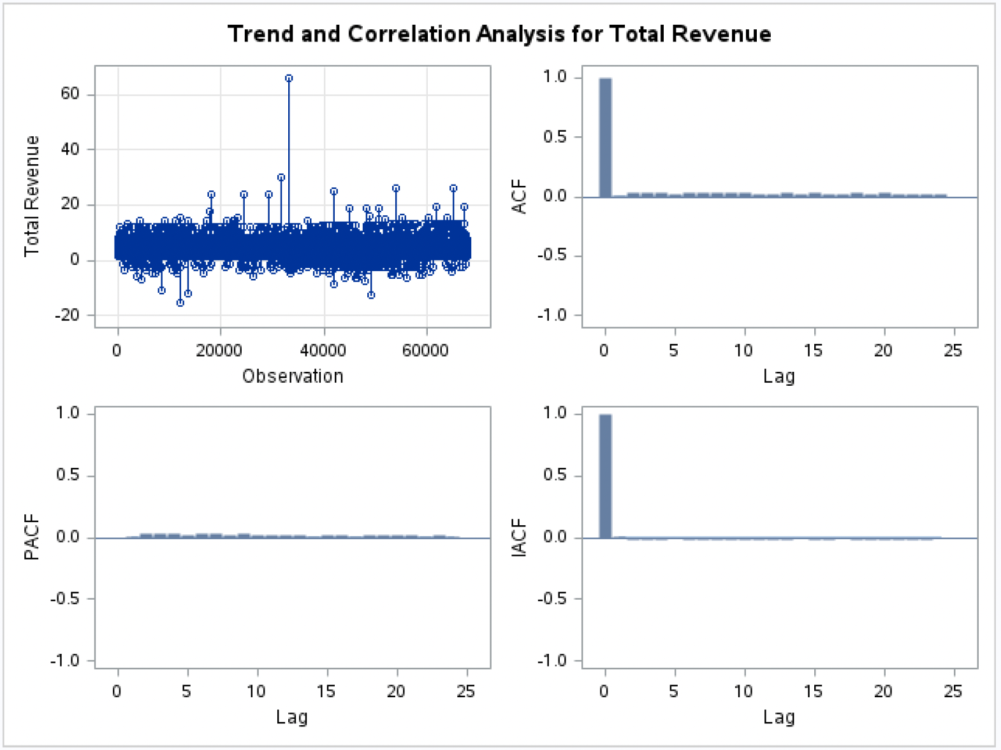
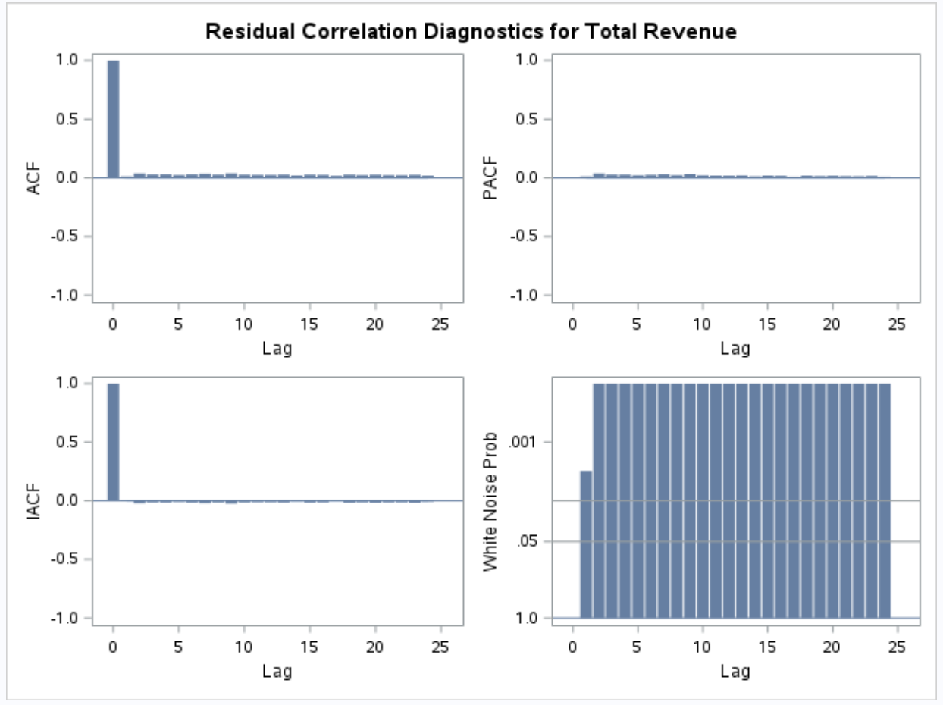
Autocorrelation
From the Autocorrelation Function (ACF) graph, we can derive that the first bar is at y-axis of 1.0, this means that the revenue on a given day is correlated with itself at once, indicating a full correlation. However after lag 0, the values are close to 0, depicting that there is a low predictive power and there is almost no relationship.

Slide 12
06
Time Series Exploration - SAS STUDIO

Slide 13
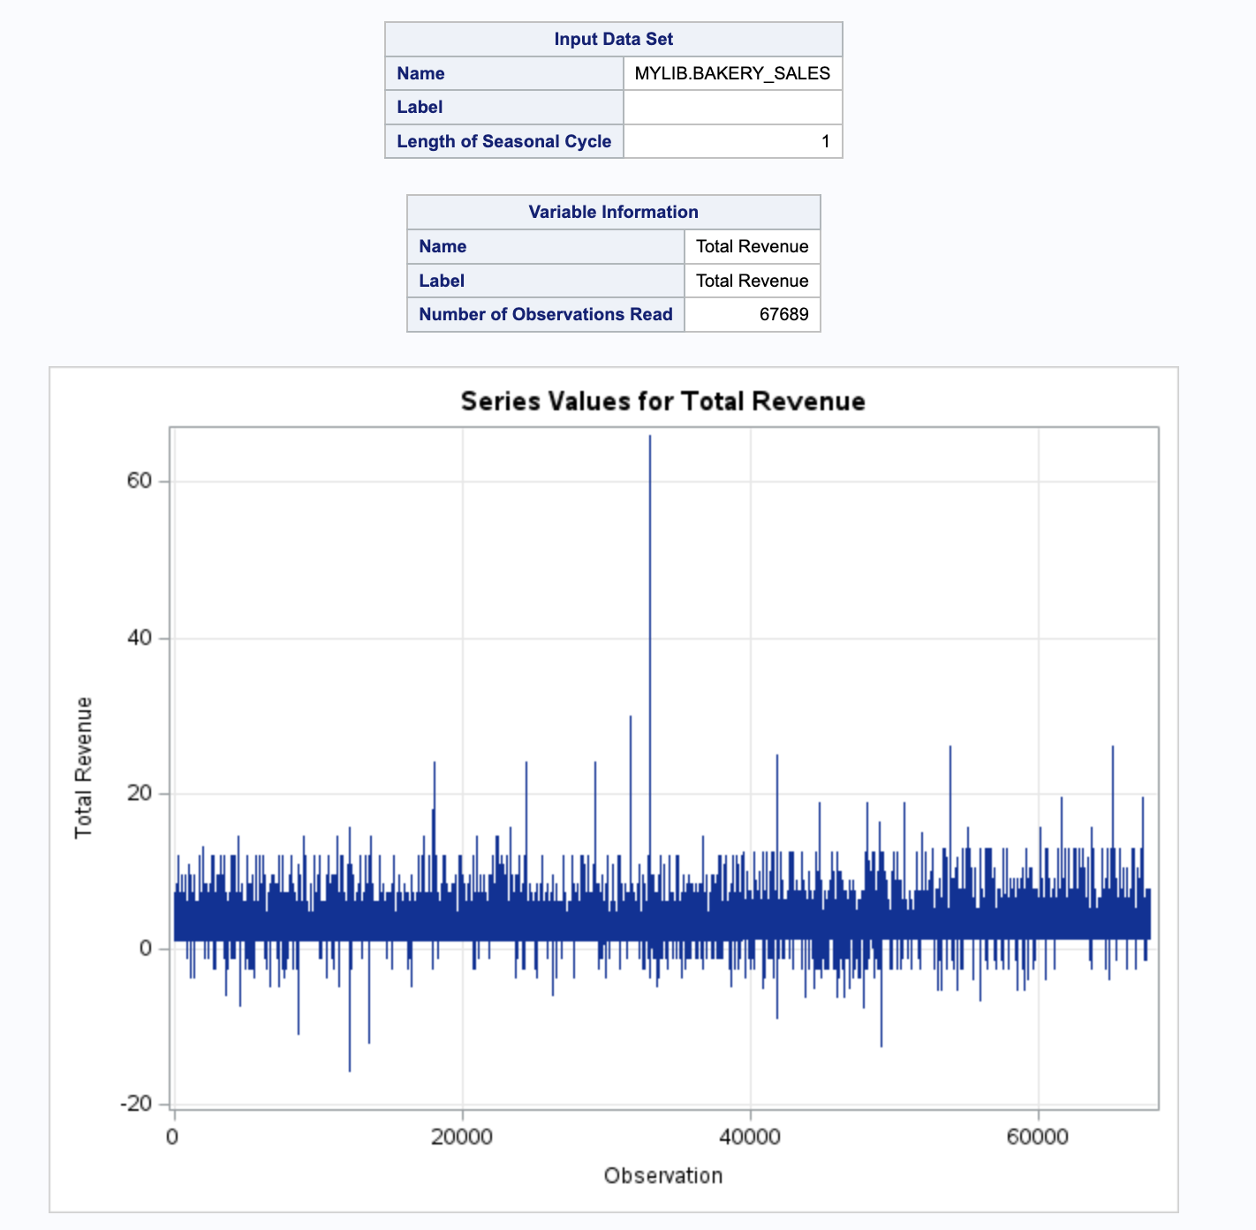
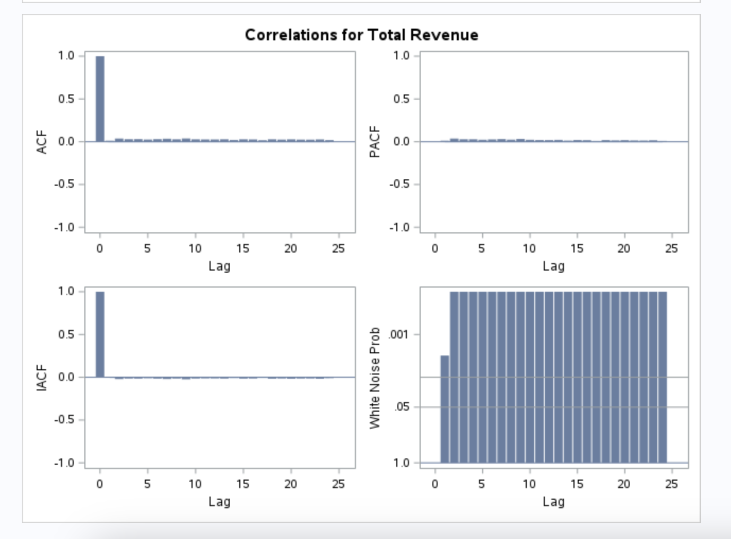
The series values graph shows the correlation between a time series and a lagged version of itself, where the data on one day is predictive on the data of the next day/time interval. Since the data points on the series values are on the same range, it suggests that the series do not have strong dependencies on its past values, signifying weak autocorrelation. This is further supported by the ACF graph that indicates low predictive power after lag 0, as values are close to 0.

Slide 14
07
MultiVariate Linear Regression - SAS STUDIO
*Regression equations omitted due to large number of variables

Slide 15
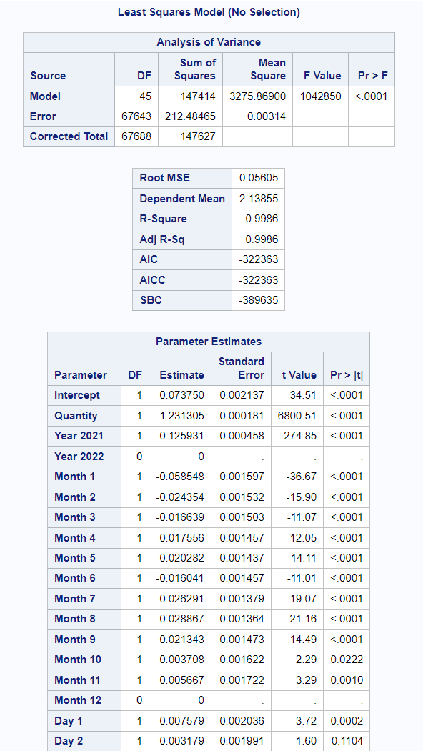
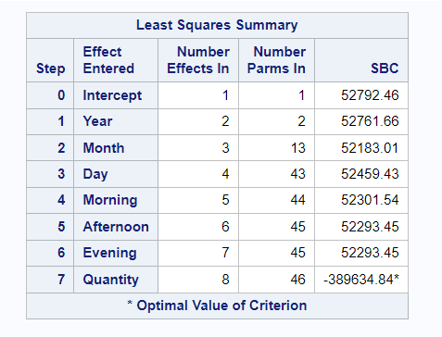
Linear Regression Model 1 in SAS Studio
This model incorporates six categorical variables and one continuous variable (Quantity Sold on the day). We leveraged various time periods (Year, Month, Day) and times of day (Morning, Afternoon, Evening) to evaluate the significance of when orders were placed on total revenue.
R-Square = 0.9986
Adj R-Sq = 0.9986
Dependent Variable - Total Revenue

Slide 16
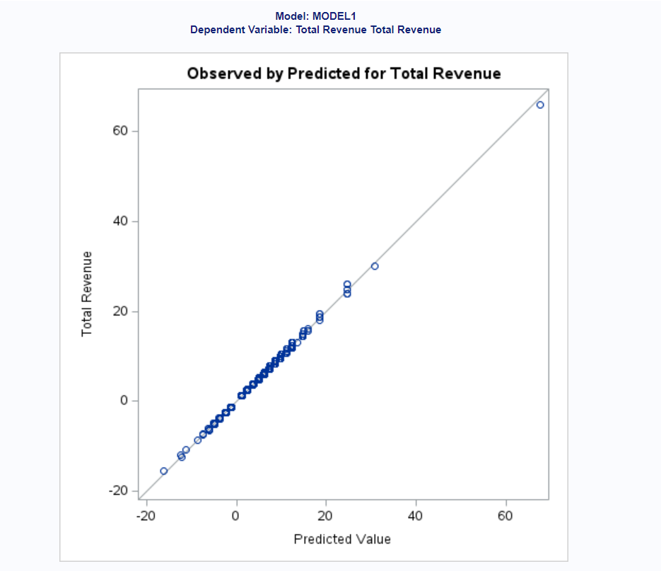
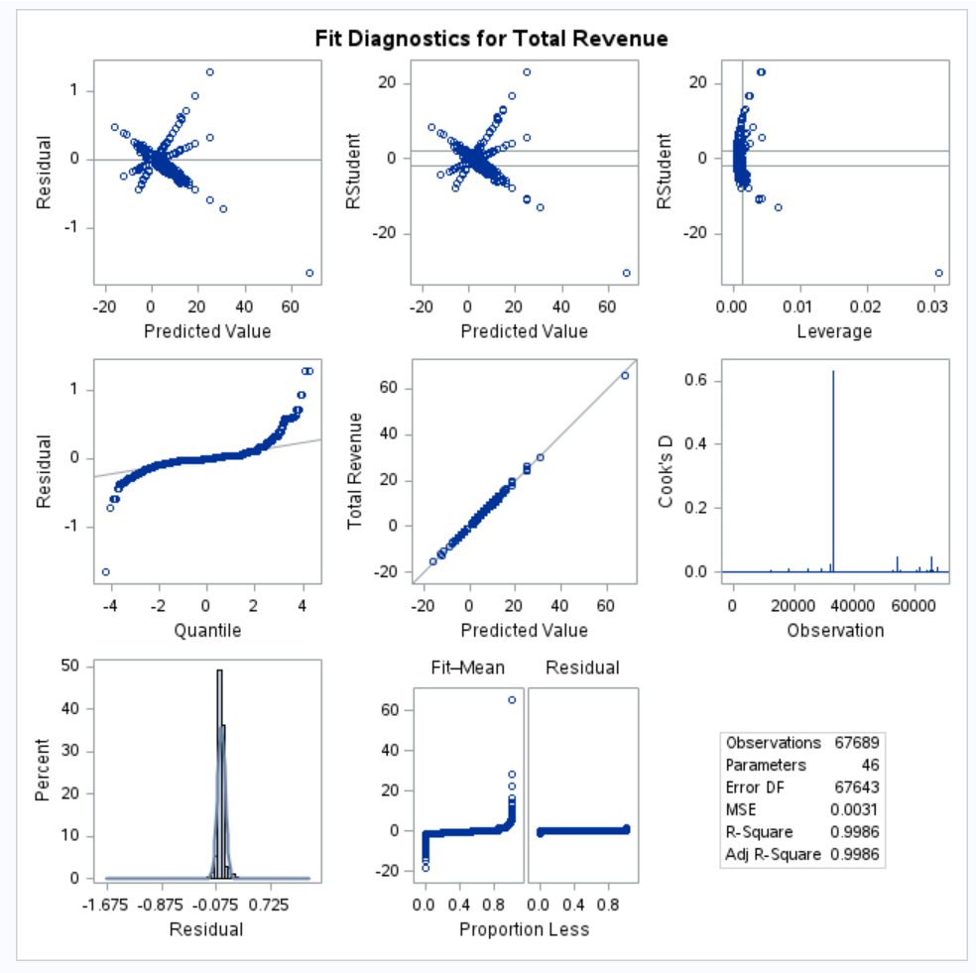
Linear Regression Model 1 in SAS Studio

Slide 17
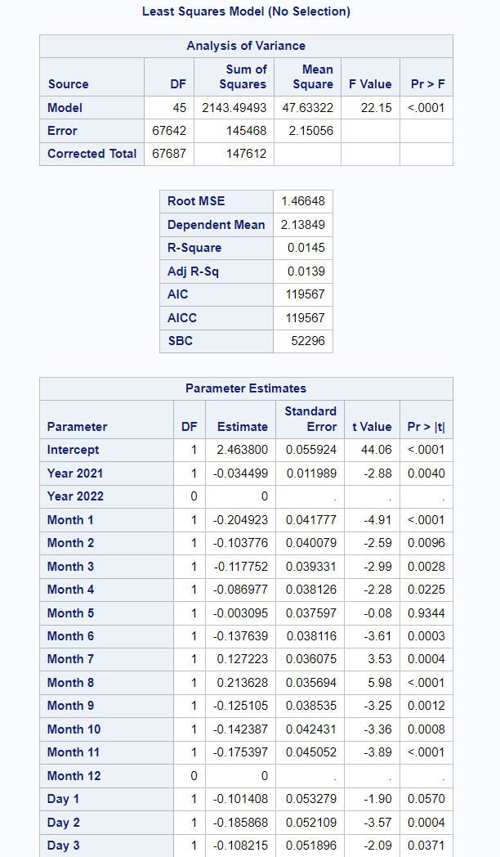
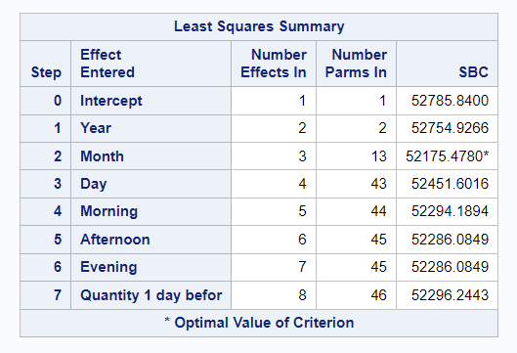
Linear Regression Model 2 in SAS Studio
This model comprises six categorical variables and one continuous variable (Quantity Sold One Day Before). We employed different time periods (Year, Month, Day) and times of day (Morning, Afternoon, Evening) to evaluate the significance of order placement timing on total revenue.
R-Square = 0.0145
Adj R-Sq = 0.0139
Dependent Variable - Total Revenue

Slide 18
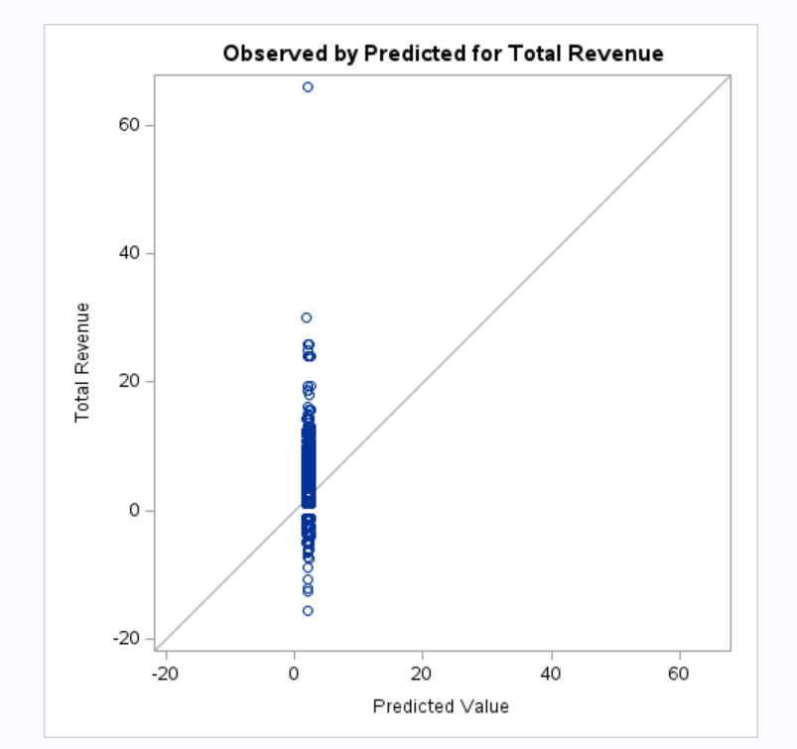
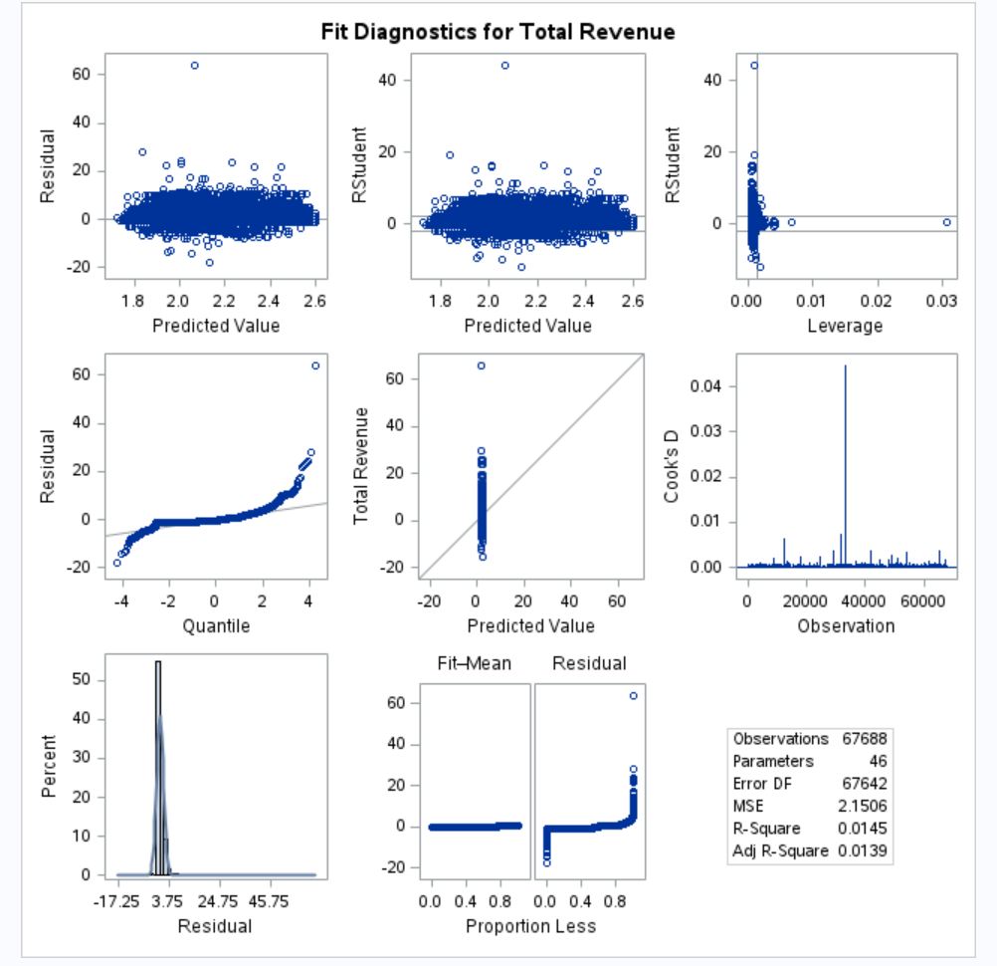
Linear Regression Model 2 in SAS Studio

Slide 19
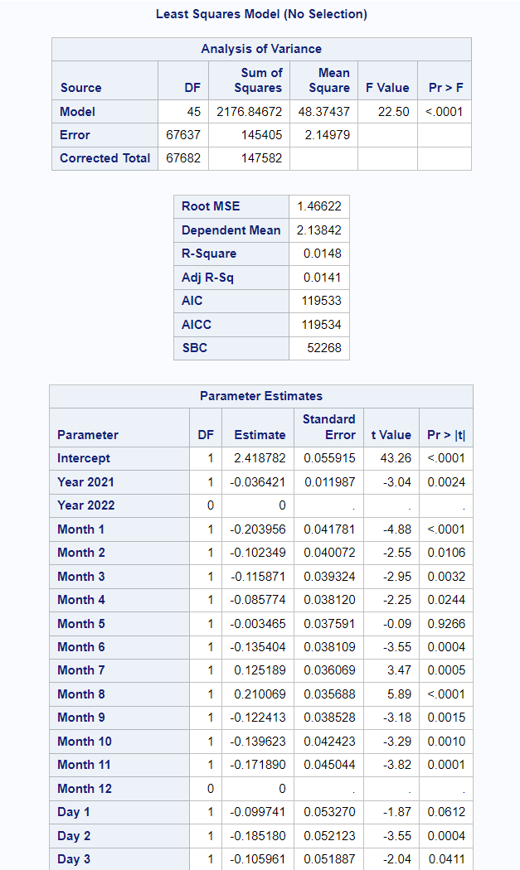
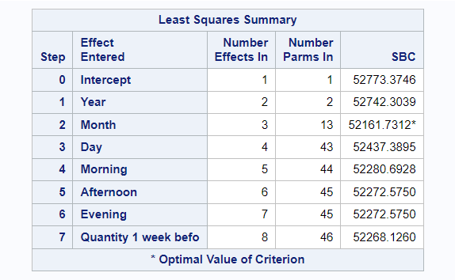
Linear Regression Model 3 in SAS Studio
This model incorporates six categorical variables and one continuous variable (Quantity One Week Before). We utilized various time periods (Year, Month, Day) and times of day (Morning, Afternoon, Evening) to evaluate the significance of order placement timing on total revenue.
R-Square = 0.0148
Adj R-Sq = 0.0141
Dependent Variable - Total Revenue

Slide 20
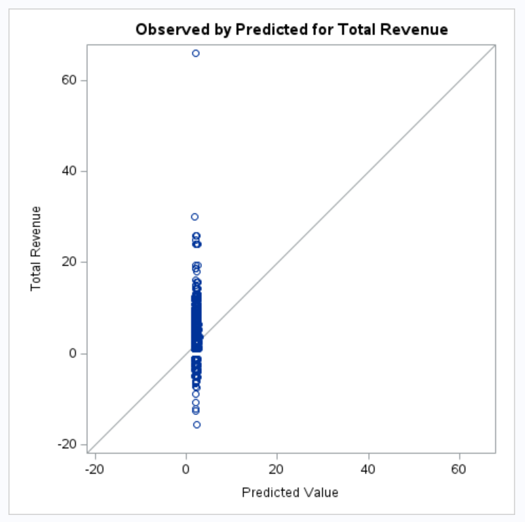
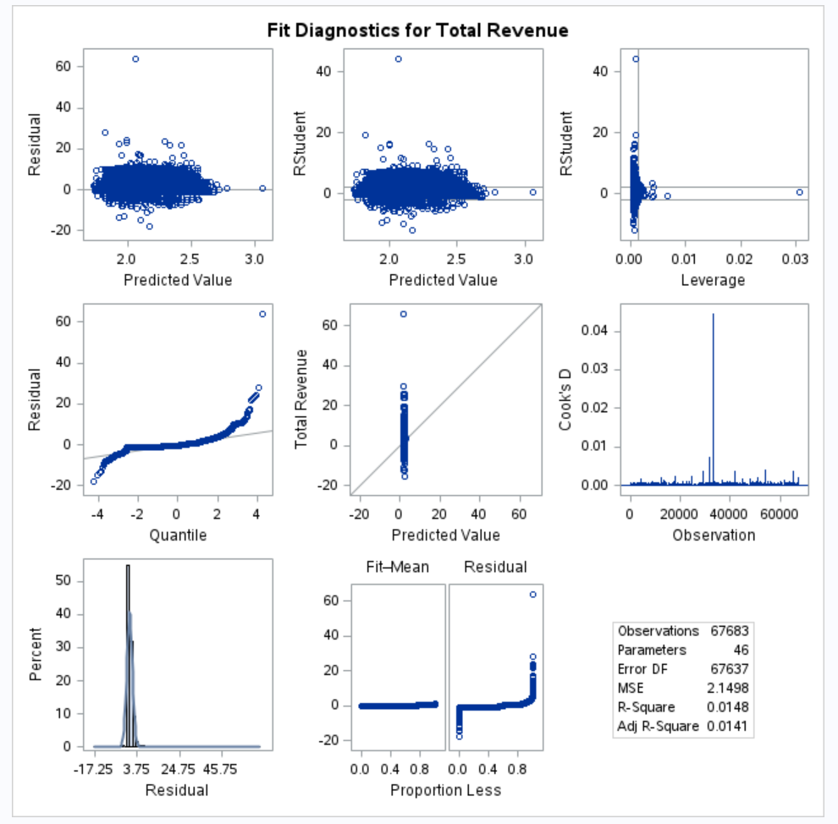
Linear Regression Model 3 in SAS Studio

Slide 21
08
Conclusions

Slide 22
Conclusion #1
The significant fluctuations in daily total revenue highlight the need for a deeper investigation into the underlying reasons behind such volatility at the bakery. This investigation could entail examining factors such as foot traffic at the store or promotions held, which may not be captured within our dataset.
Conclusion #3
Since the Autocorrelation Function (ACF) graph that depicts low predictive power after lag 0, this suggests that it can primarily be due to the volatile nature of bakery sales as it is a perishable good. Other factors may include the seasonality of sales due to holidays or weather conditions and irregular sales patterns of bakery sales.
Conclusion #2
We've noticed distinct patterns of exceeding the upper control limit, particularly in May and December. These spikes coincide with major events like college graduations and the Christmas holiday season. Traditional Baguettes tend to be a popular choice during these times, leading to increased revenue levels.
Conclusion #4
The 'Quantity' variable accounts for over 95% of the variance in Total Revenue. Among the three regression models executed, two exhibited abysmal R-Square values of less than 0.02, while one exhibited an impressive R-Square value of 0.99. The critical disparity lies in the inclusion of 'Quantity' as a predictor variable in the high-performing regression model, while the low-performing regression models incorporated 'Quantity 1 day before' and 'Quantity 1 week before'. Given the ACF's depiction of low predictive power on past values, indicating weak autocorrelation, the regression models with low R-Squares also corroborate this conclusion.

